Slide 1
Analyzing the Impact of Car Features on Price and Profitability

Slide 2
This project involves creating a comprehensive dashboard to analyze various attributes of vehicles, such as horsepower, fuel efficiency, and pricing. The dataset contains information about multiple car brands, models, and specifications, including engine type, transmission, driven wheels, and market categories. The goal is to uncover patterns and insights that can help understand the influence of these attributes on car prices and performance.
DESCRIPTION

Slide 3
APPROACH AND TECH STACK USED
Tech Stack used
Microsoft Excel for analyzing the data and extracting insights.
Power query editor for cleaning the data.
Microsoft Power BI to create dashboard.
Microsoft Powerpoint to create presentation.

Slide 4
Cleaning the Data
I have used power query editor in excel to clean the data.
In order to find the empty values i have used column quality option.
Further i have cleared the rows with empty values by using remove rows option
In the next step to have changed the data type of the column model to text and the column MSRP to currency.

Slide 5
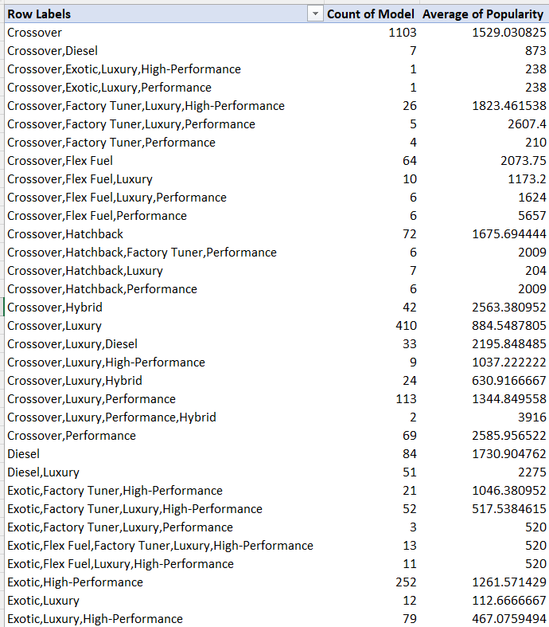
Task 1.A: Create a pivot table that shows the number of car models in each market category and their corresponding popularity scores.
Crossover has the highest number of cars with 1103, followed by Flex Fuel and Luxury.

Slide 6
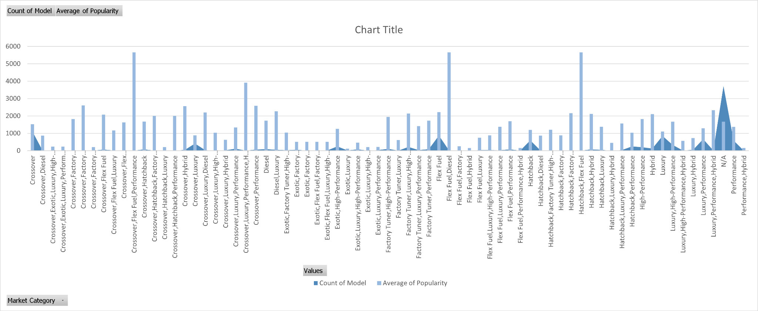
Task 1.B: Create a combo chart that visualizes the relationship between market category and popularity.

Slide 7
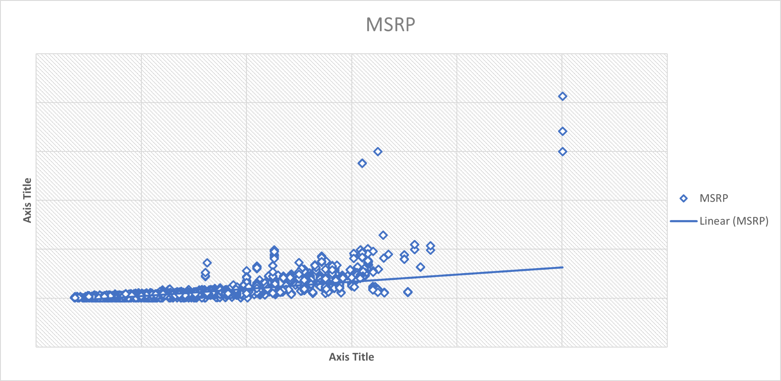
Task 2: Create a scatter chart that plots engine power on the x-axis and price on the y-axis. Add a trendline to the chart to visualize the relationship between these variables.
Higher the engine power higher the prize of the car.

Slide 8
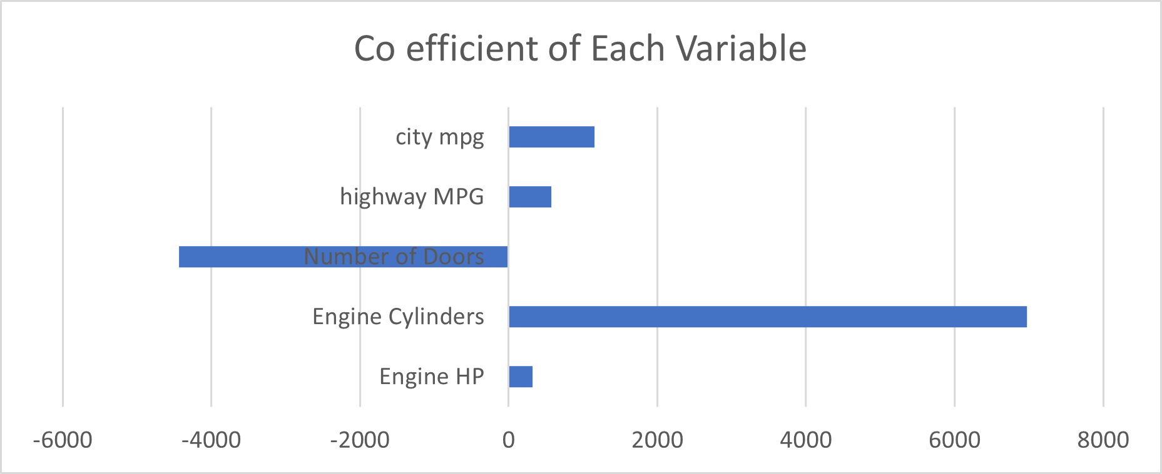
Task 3: Use regression analysis to identify the variables that have the strongest relationship with a car's price. Then create a bar chart that shows the coefficient values for each variable to visualize their relative importance.
The engine cylinder is the most important factor in determining car’s price.

Slide 9
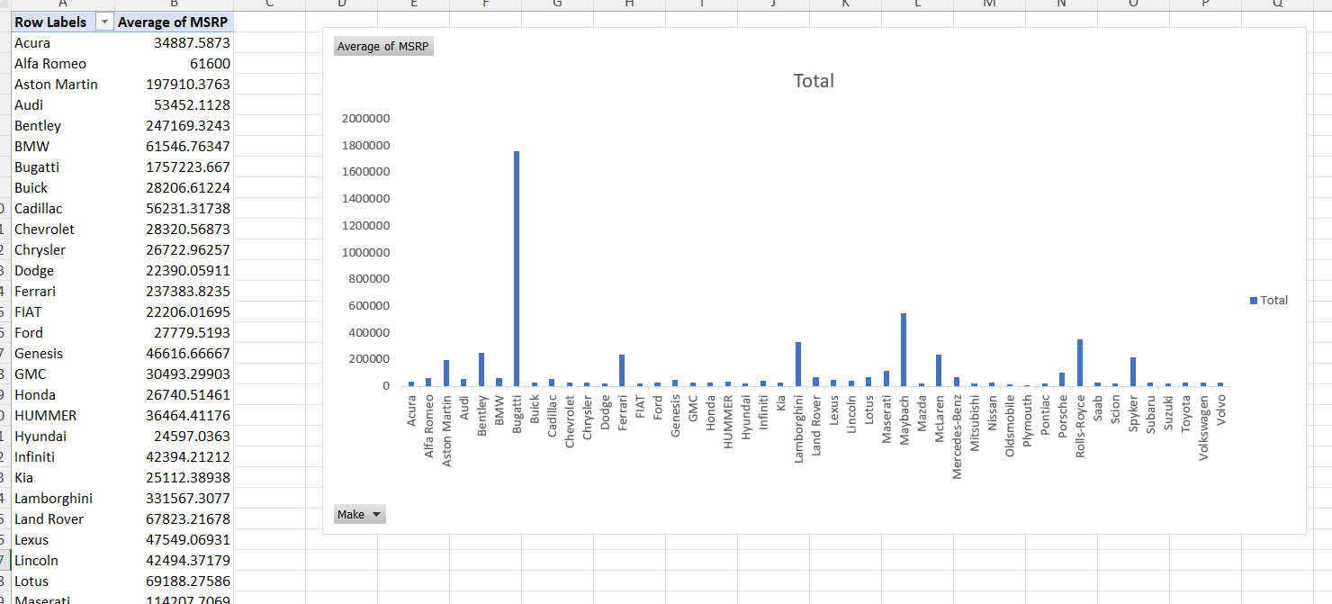
Task 4.A: Create a pivot table that shows the average price of cars for each manufacturer.
Task 4.B: Create a bar chart or a horizontal stacked bar chart that visualizes the relationship between manufacturer and average price.
Bugatti has the highest MSRP average which is about 1757223.667

Slide 10
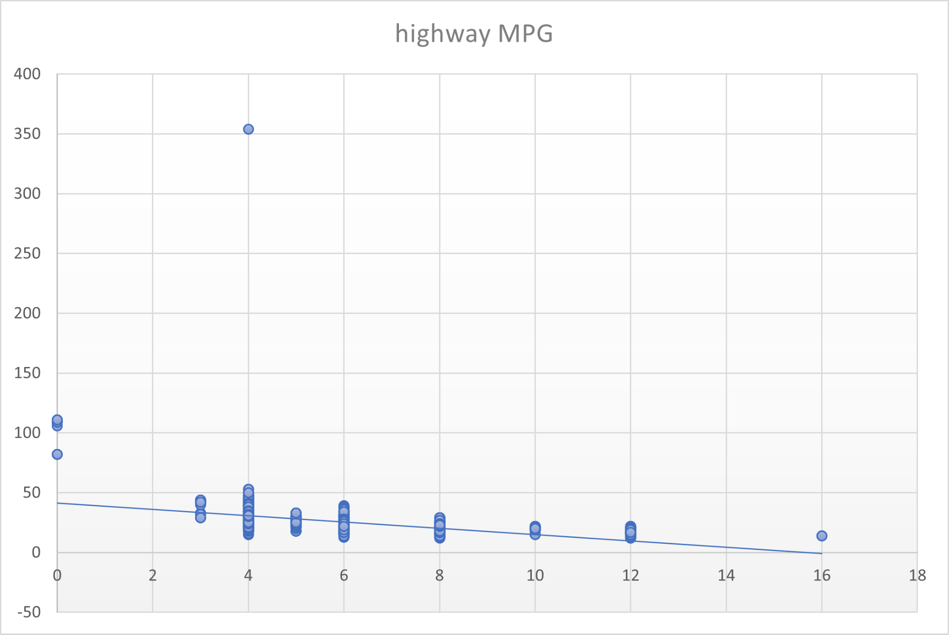
Task 5.A: Create a scatter plot with the number of cylinders on the x-axis and highway MPG on the y-axis. Then create a trendline on the scatter plot to visually estimate the slope of the relationship and assess its significance.

Slide 11
Task 5.B: Calculate the correlation coefficient between the number of cylinders and highway MPG to quantify the strength and direction of the relationship.
The Correlation Coefficient between the number of cylinders and highway MPG is -0.61963.

Slide 12
Building the Dashboard
To build the dashboard I have used Microsoft Power BI
There are few new calculation done beforehand so that it would be easy to develop the dashboard.
Those values would be:
Average Horsepower
Average MPG
Average MSRP
Transmission Count

Slide 13
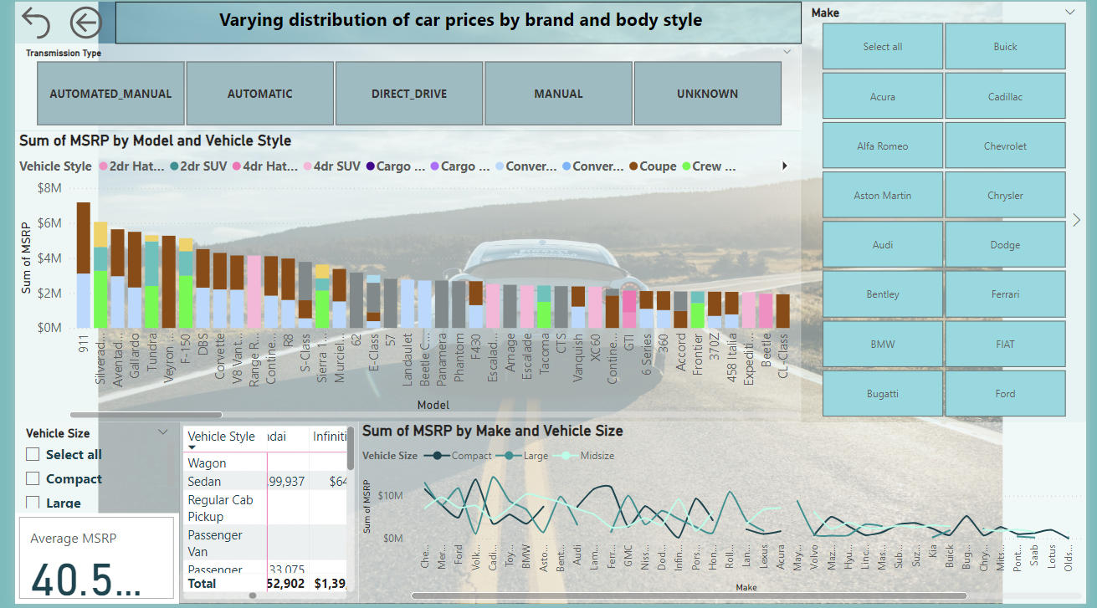
Task 1: How does the distribution of car prices vary by brand and body style?

Slide 14
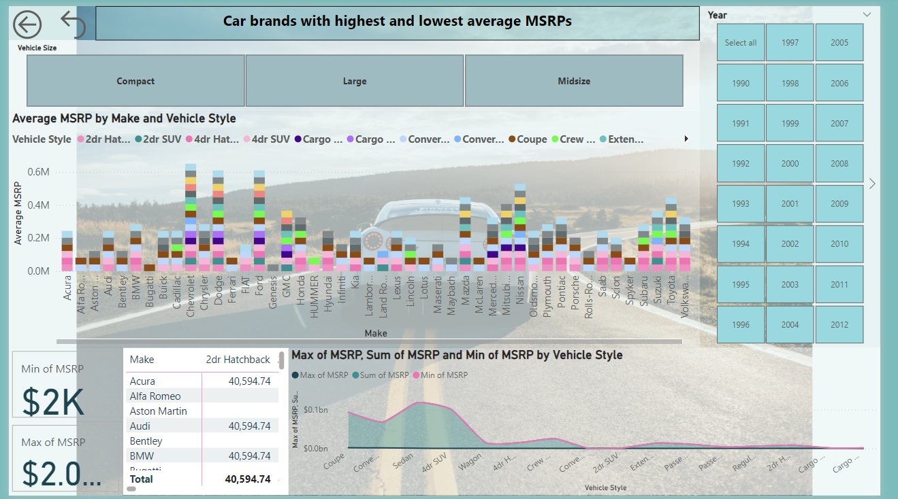
Task 2: Which car brands have the highest and lowest average MSRPs, and how does this vary by body style?

Slide 15
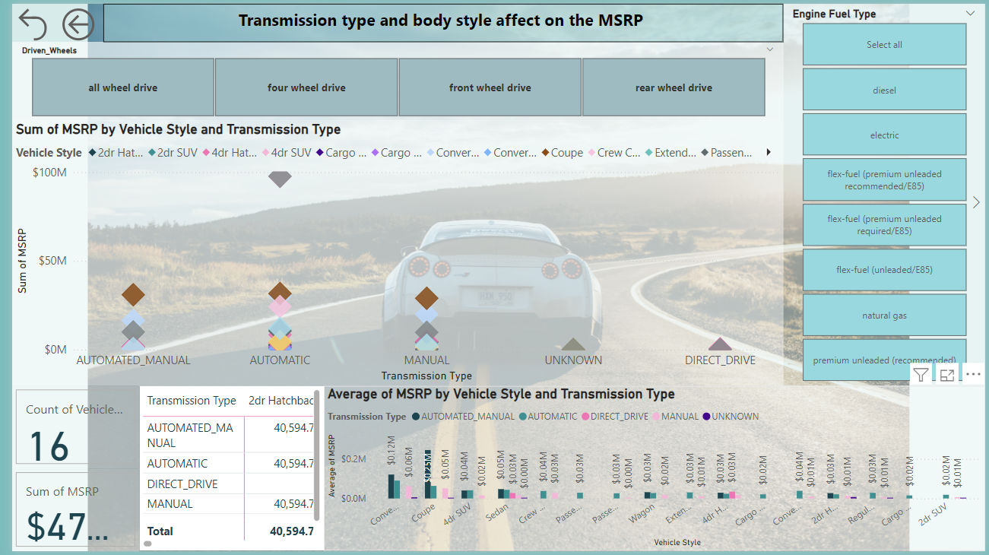
Task 3: How do the different feature such as transmission type affect the MSRP, and how does this vary by body style?

Slide 16
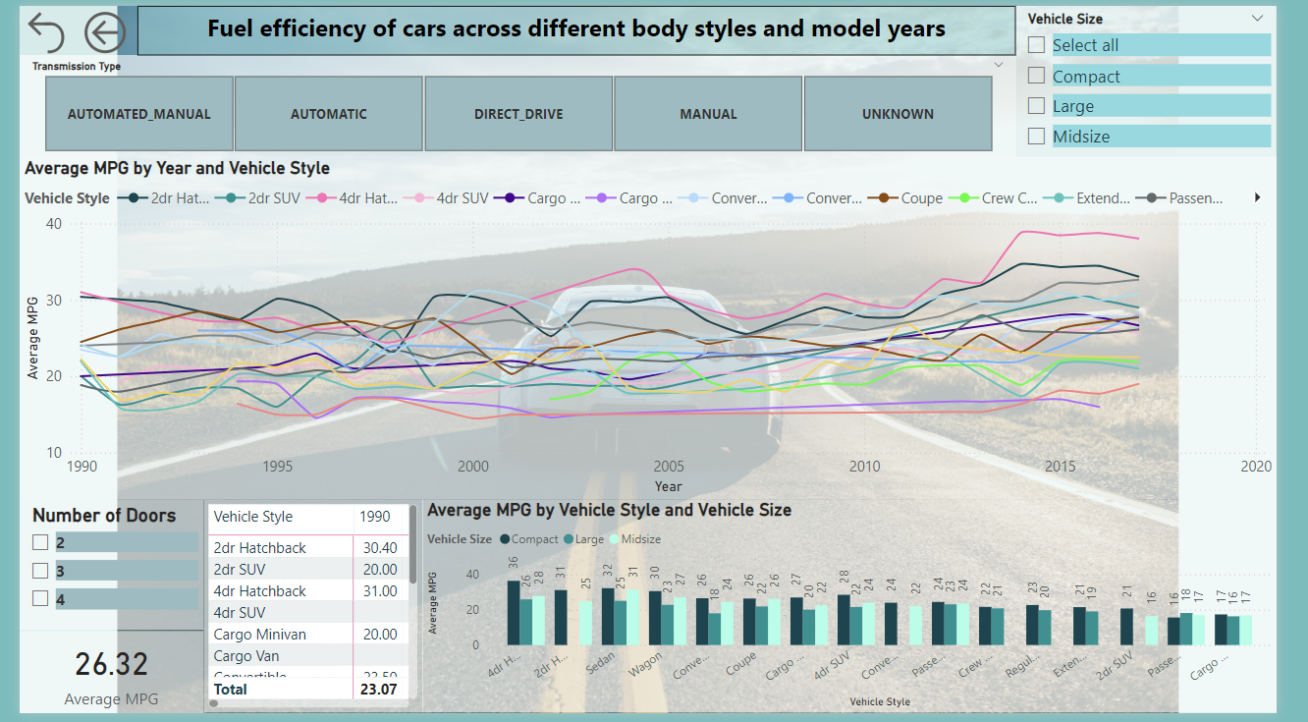
Task 4: How does the fuel efficiency of cars vary across different body styles and model years?

Slide 17
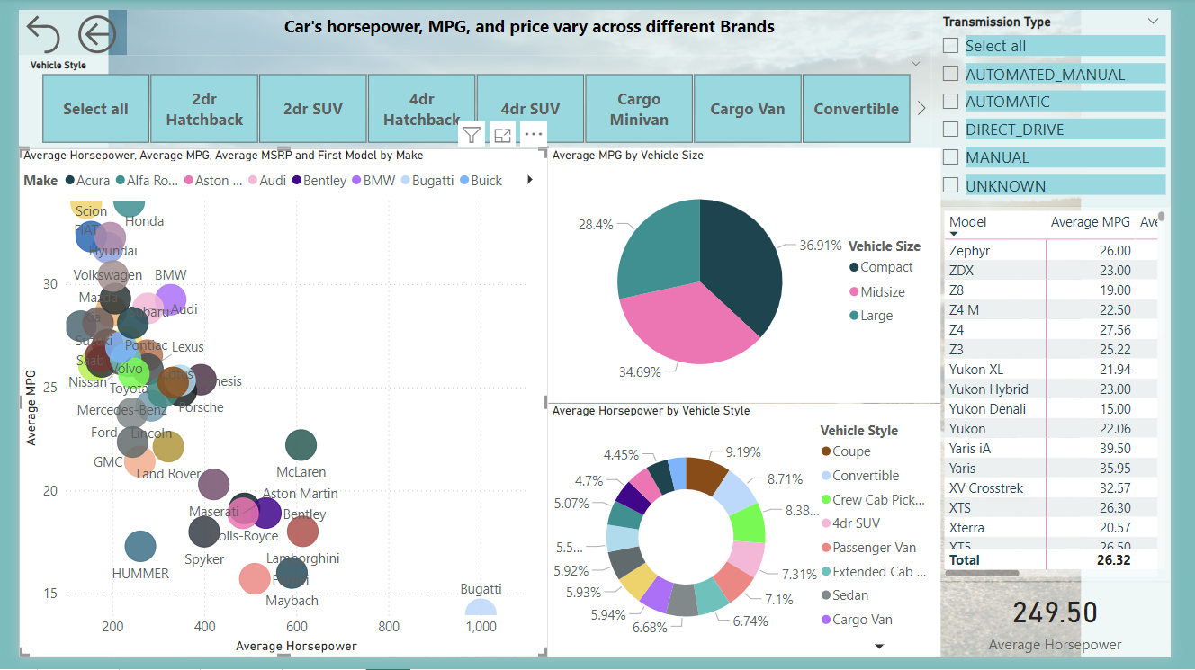
Task 5: How does the car's horsepower, MPG, and price vary across different Brands?

Slide 18
THANK YOU
LINKS
EXCEL:LINK
POWER BI:LINK

